Slide 1
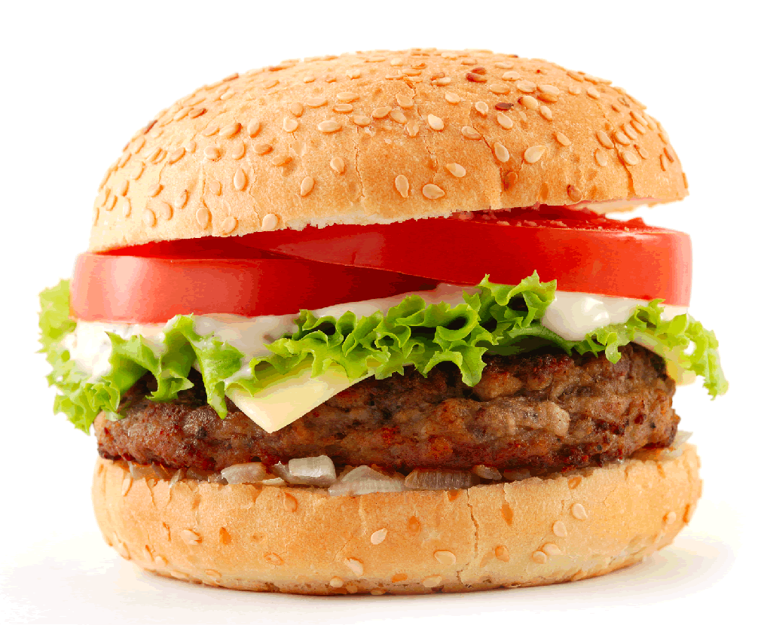
Fast Foods Nutrition Analysis
Know your food & restaurants

Slide 2
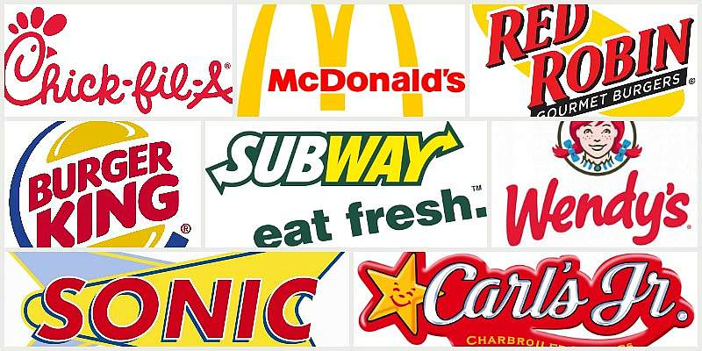
Motivation & Summary
Fast-Food restaurants are everywhere. We all know, cheese burgers, fries, nuggets.. Etc are not ideal for a fit & healthy lifestyle - but there’s no escape from fast food. We have got our hands on nutrition facts on some of the most common items from well known fast food restaurant chains. We will evaluate best and most preferred restaurants and will spread awareness of which restaurant is less unhealthy.
In this presentation we try to answer these questions:
What is the nutritional value compared between these competing restaurants and common food types?
Which fast food chain is the most dominant in San Francisco?
What do people in San Francisco think about these restaurants on social media?

Slide 3
Our Agenda
Analysis
Between some of the major key players in the fast food industry, we want to spread awareness of their nutrition facts, identify their presence in San Francisco and how social media perceives of them.
Nutrition Analysis
Know Your Food
San Francisco
Social
Conclusion

Slide 4
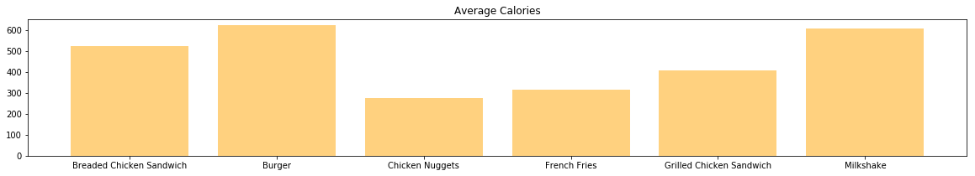
Nutrition Analysis
Know your food
Based on the data facts from the famous fast food restaurants, these are a few common food type that you would find in all the major fast food chains.
Here you can see average of calories from the most common food type.

Slide 5
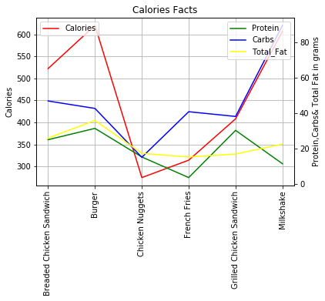
Nutrition Analysis

Slide 6
Know your food
PIE CHART

Slide 7
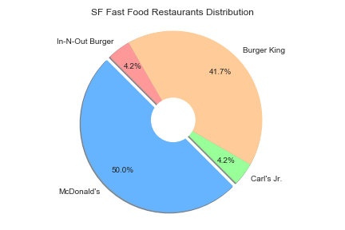
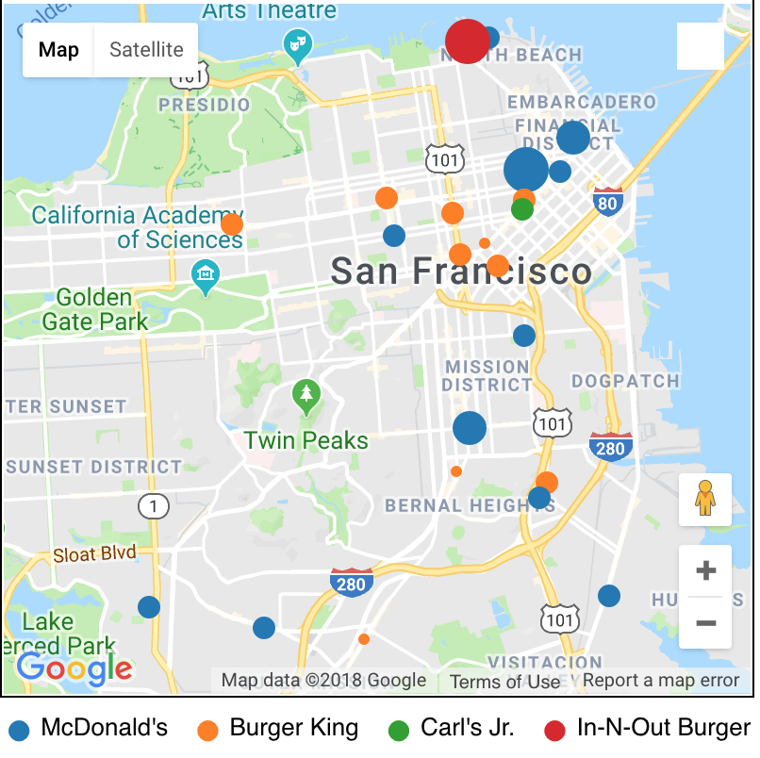
San Francisco
Who has the most footprint in San Francisco?
API
Wrapper
API
Google Maps API, Yelp API
gmaps
Yelp API
Radius of Data Points = Yelp’s Average Rating

Slide 8
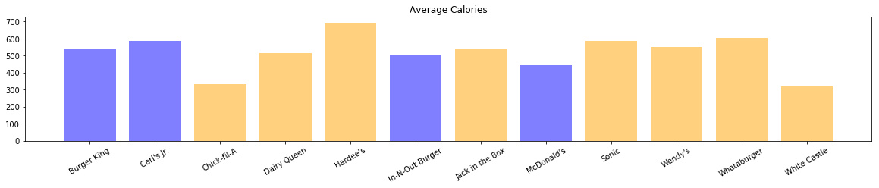
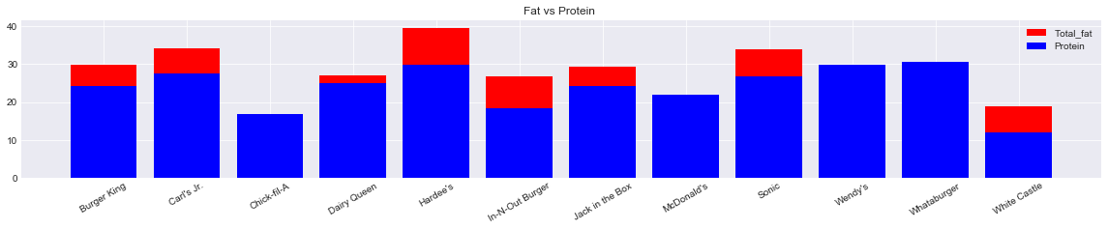
Nutrition Analysis
Know your restaurants

Slide 9
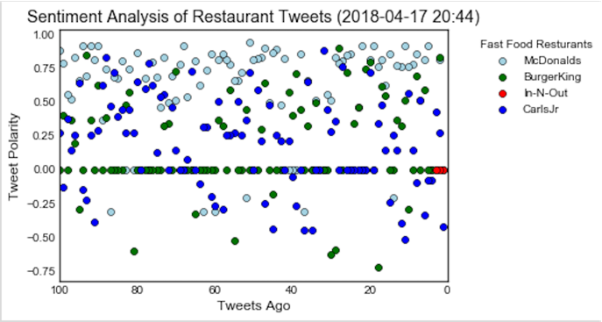
Sentiment Analysis from Twitter

Slide 10
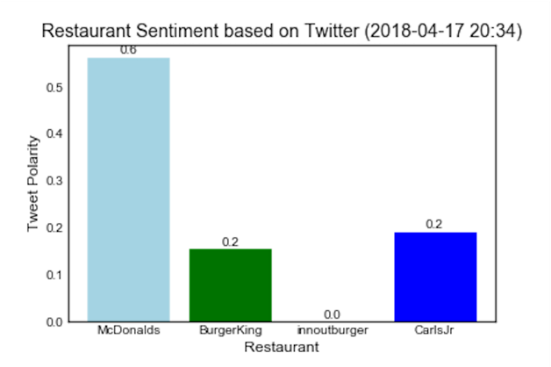
San Francisco Favourite
Compound Comparison

Slide 11
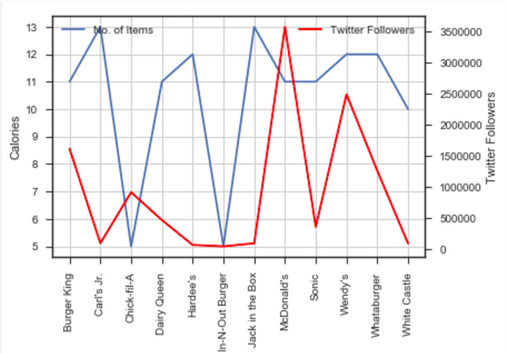
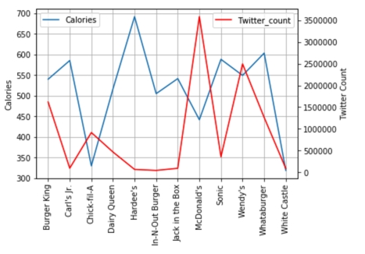
Quick Comparison

Slide 12

CONCLUSION
Grilled Chicken Sandwich is the way to go
McDonald’s has the most
presence in San Francisco
Placeholder
This is a Subtitle
Notes:
<a href='http://www.freepik.com/free-photo/close-up-of-financial-report-with-businesspeople-background_867775.htm'>Designed by Freepik</a>

Slide 13
@team1-project1
THANK
YOU

